Slide 1

Evidence Collection
By
Dr Yasir Afaq
Lecture-3

Slide 2
Digital Evidence Collection
Forensics is the use of scientific knowledge to collect, analyze, and present digital evidence to court.
Digital Forensic examiners draw on an array of techniques for discovering data from a computer, often for recovering deleted, encrypted, or damaged files (graphics, documents, images and so forth).
All of this information is crucial, especially during discovery, prior to depositions, or in preparation for criminal or civil litigation. Much of the information to be recovered may not be found in simply deleted files.
It may be hidden in other data files such as HTML, e-mail entries, and information recovered from hard disk areas such as the virtual memory, slack space, or recycle bin.

Slide 3
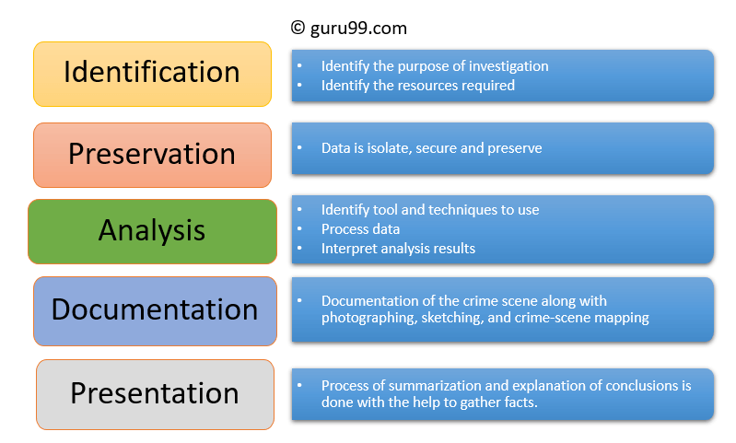
Process of Digital forensics
Digital forensics entails the following steps:
Identification
Preservation
Analysis
Documentation
Presentation

Slide 4

Process
Identification
It is the first step in the forensic process. The identification process mainly includes things like what evidence is present, where it is stored, and lastly, how it is stored (in which format).
Electronic storage media can be personal computers, Mobile phones, PDAs, etc.
Preservation
In this phase, data is isolated, secured, and preserved. It includes preventing people from using the digital device so that digital evidence is not tampered with.
Analysis
In this step, investigation agents reconstruct fragments of data and draw conclusions based on evidence found. However, it might take numerous iterations of examination to support a specific crime theory.

Slide 5

Process
Documentation
In this process, a record of all the visible data must be created. It helps in recreating the crime scene and reviewing it. It Involves proper documentation of the crime scene along with photographing, sketching, and crime-scene mapping.
Presentation
In this last step, the process of summarization and explanation of conclusions is done.
However, it should be written in a layperson’s terms using abstracted terminologies. All abstracted terminologies should reference the specific details.

Slide 6
Types of Digital Forensics
Disk Forensics:
It deals with extracting data from storage media by searching active, modified, or deleted files.
Network Forensics:
It is a sub-branch of digital forensics. It is related to monitoring and analysis of computer network traffic to collect important information and legal evidence.
Wireless Forensics:
It is a division of network forensics. The main aim of wireless forensics is to offers the tools need to collect and analyze the data from wireless network traffic.
Database Forensics:
It is a branch of digital forensics relating to the study and examination of databases and their related metadata.
Malware Forensics:
This branch deals with the identification of malicious code, to study their payload, viruses, worms, etc.
Email Forensics
Deals with recovery and analysis of emails, including deleted emails, calendars, and contacts.
Memory Forensics:
It deals with collecting data from system memory (system registers, cache, RAM) in raw form and then carving the data from Raw dump.

Slide 7

Challenges faced by Digital Forensics
Here, are major challenges faced by the Digital Forensic:
The increase of PC’s and extensive use of internet access
Easy availability of hacking tools
Lack of physical evidence makes prosecution difficult.
The large amount of storage space into Terabytes that makes this investigation job difficult.
Any technological changes require an upgrade or changes to solutions.

Slide 8
Example Uses of Cyber forensics Forensics
In recent time, commercial organizations have used digital forensics in following a type of cases:
Intellectual Property theft
Industrial espionage
Employment disputes
Fraud investigations
Inappropriate use of the Internet and email in the workplace
Forgeries related matters
Bankruptcy investigations
Issues concern with the regulatory compliance

Slide 9
Cyber Crime Investigation?
A comparison of cyber crime investigations and physical-world criminal investigations reveals a primary difference: evidence in criminal investigations is mostly digital in nature.
A cyber crime investigation is the process of investigating, analyzing, and recovering forensic data for digital evidence of a crime.
Examples of evidence in a cyber crime investigation include a computer, cellphone, automobile navigation system, video game console, or other networked device found at the scene of a crime.
This evidence helps cyber crime investigators determine the perpetrators of a cyber crime and their intent.

Slide 10

Organizations Conduct Cyber Crime Investigations
The following organizations aim to prevent cyber crime from happening through deterrence, monitoring, and education:
Criminal Justice and Law Enforcement Agencies
The criminal justice system is made up of a network of agencies, including law enforcement, the judiciary, and corrections. Individuals who work in criminal justice agencies include law enforcement officers, prosecutors, and judges. These agencies work independently, yet work together to investigate and prosecute violations of cyber crime laws. Each branch of the criminal justice system is responsible for a certain area of the criminal justice process.
Law enforcement (police officers, agents, and investigators) is responsible for gathering evidence of a crime, arresting a suspect, and charging the suspect with the crime.
The judiciary consists of lawyers who present their evidence against the charged individual, lawyers who defend the individual, judges who preside over the proceedings, and juries who decide whether the individual is guilty or innocent.
Corrections agencies ensure that prosecuted criminals remain behind bars during their sentences.
The FBI is the primary federal law enforcement agency that investigates cyber crime domestically and abroad. Other agencies include the U.S Secret Service, U.S. Immigration and Customs Enforcement (ICE), U.S. Postal Inspection Service, and the Bureau of Alcohol, Tobacco, Firearms and Explosives (ATF). These agencies have local offices in each state. State and local law enforcement agencies also investigate cyber crimes that take place in their jurisdictions.

Slide 11
Cyber Crime Investigation Techniques
Activities that a computer crime investigator performs include recovering file systems of hacked computers, acquiring data that can be used as evidence to prosecute crimes, writing reports for use in legal proceedings, and testifying in court hearings. Cyber crime investigation techniques include:
Performing background checks: Establishing the when, where, and who of a crime sets the stage for an investigation. This technique uses public and private records and databases to find out the backgrounds of individuals potentially involved in a crime.
Gathering information: This technique is one of the most critical in cyber crime investigations. Here, investigators ask questions such as: What evidence can be found? What level of access to sources do we have to gather the evidence? The answers to these and other questions provide the foundation for a successful investigation.
Running digital forensics: Cyber crime investigators use their digital and technology skills to conduct forensics, which involves the use of technology and scientific methods to collect, preserve, and analyze evidence throughout an investigation. Forensic data can be used to support evidence or confirm a suspect’s involvement in a crime.
Tracking the authors of a cyber crime: With information about a crime in hand, cyber crime investigators work with internet service providers and telecommunications and network companies to see which websites and protocols were used in the crime. This technique is also useful for monitoring future activities through digital surveillance. Investigators must seek permission to conduct these types of activities through court orders.

Slide 12

Question?

